Slide 1

Comparing to human-level performance
Why human-level
performance?
deeplearning.ai

Slide 2
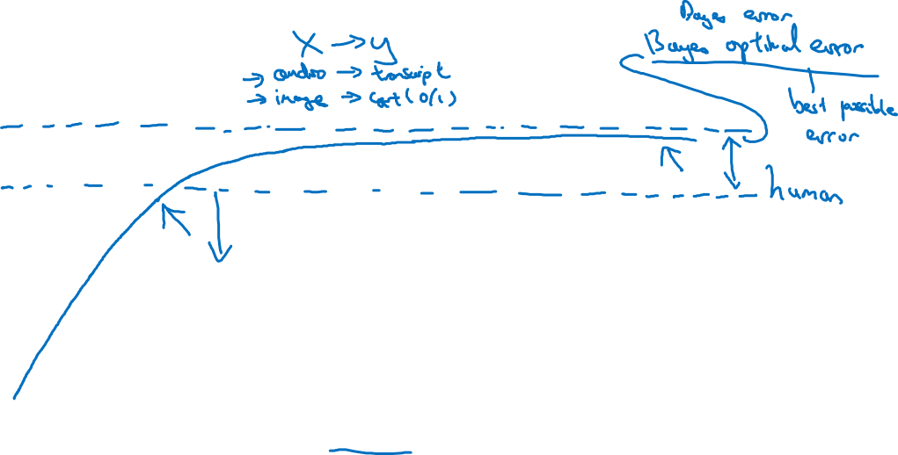
Comparing to human-level performance
Q: why progress often slows down when you surpass human level performance.
accuracy
A: One reason is that human level performance is not that far from Bayes' optimal error.
time
the second reason is that so long as your performance is worse than human level performance, then there are actually certain tools you could use to improve performance

Slide 3
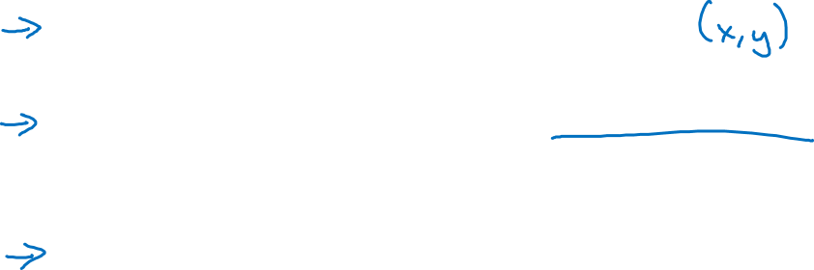
Why compare to human-level performance
Humans are quite good at a lot of tasks. So long as ML is worse than humans, you can:
Get labeled data from humans.
Gain insight from manual error analysis: Why did a person get this right?
Better analysis of bias/variance.

